Slide 1
INFDEV036A - Algorithms Lesson Unit 3
G. Costantini, F. Di Giacomo
costg@hr.nl, giacf@hr.nl – Office H4.206

Slide 2
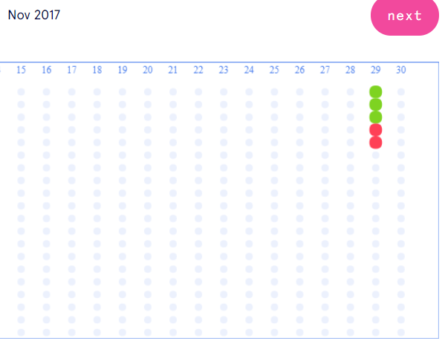
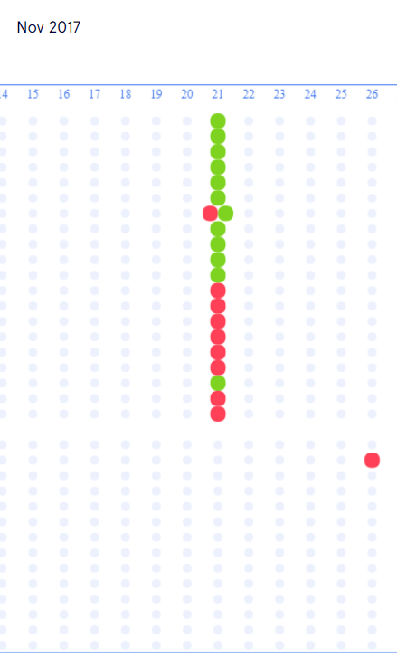
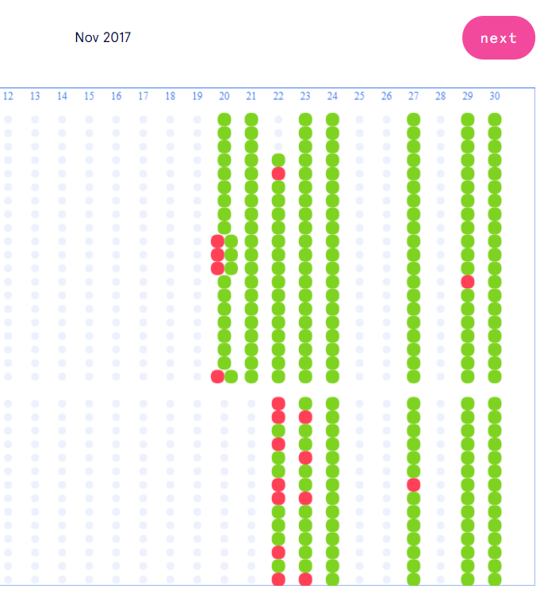
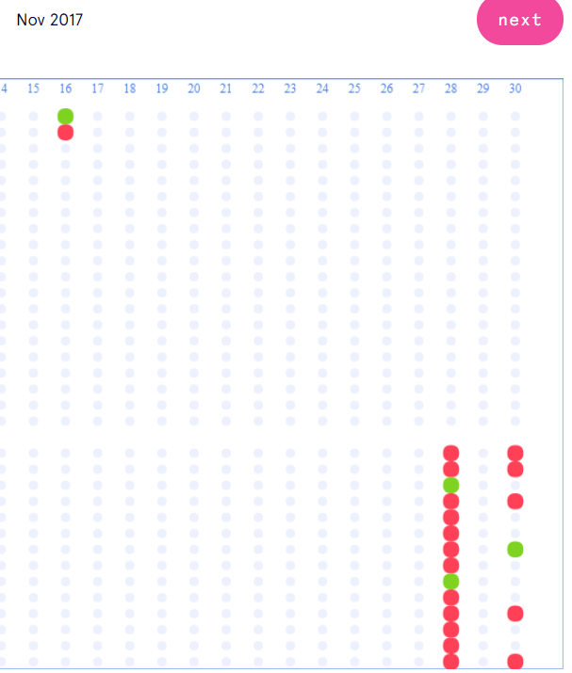
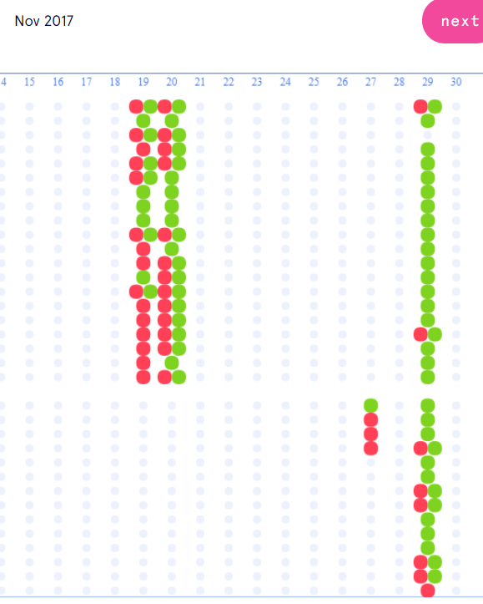
A few important reminders
Check your progress in the dashboard of GO
Every set of questions should be done multiple times, until all dots are green (without any red in between)
Make sure that you implement what we see in the lectures
As specified with more details in the “homework” slides
Remember to test your code with many possible inputs!!!
Ask when you have doubts / don’t understand

Slide 3
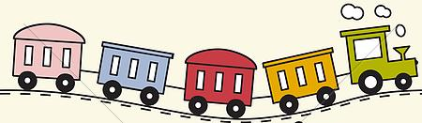



Today
LIST
Why is my code slow?
Empirical and complexity analysis
How do I order my data?
Sorting algorithms
How do I structure my data?
Linear, tabular, recursive data structures
How do I represent relationship networks?
Graphs
QUEUE
STACK
HASH TABLE

Slide 4
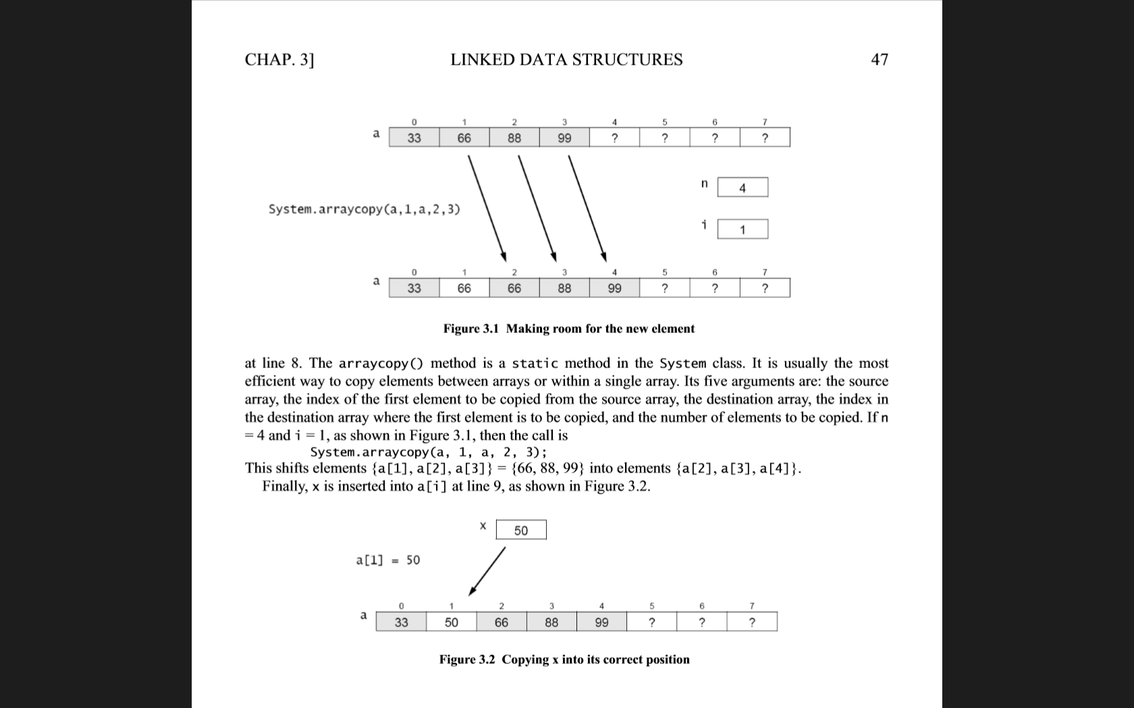
Why arrays are not enough?
Arrays are good for…
Sequential access (cache)
But not for…
Algorithmic stuff on dynamic data
Why?
In an unsorted array, searching is slow
Linear search instead of binary search
But to maintain an array sorted, inserting & deleting elements is slow
Need to shift all elements bigger than the one to insert/delete
Possible resize needed
Notes:
Unsorted sequences
Static data (does not change much)

Slide 5
Linked lists

Slide 6
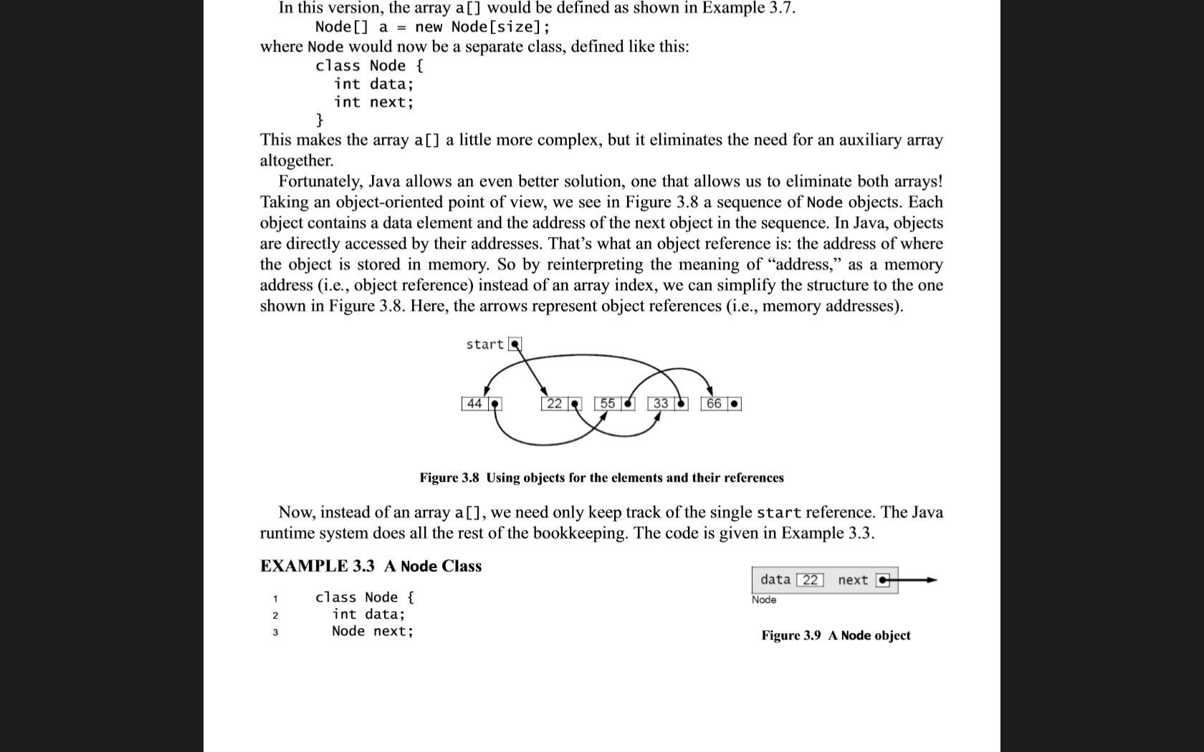
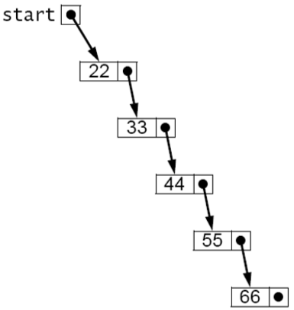
Linked list
Simple and flexible representation
Objects are arranged in linear order
Order is maintained through the use of references inside elements
Each element (node) of a list is made by
Its value
A reference to the next element of the list
A list is then defined by
The starting element
All other elements can be reached from there
Notes:
Possibly show an implementation of lists in C# → http://stackoverflow.com/questions/3823848/creating-a-very-simple-linked-list

Slide 7
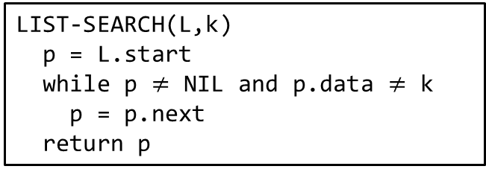
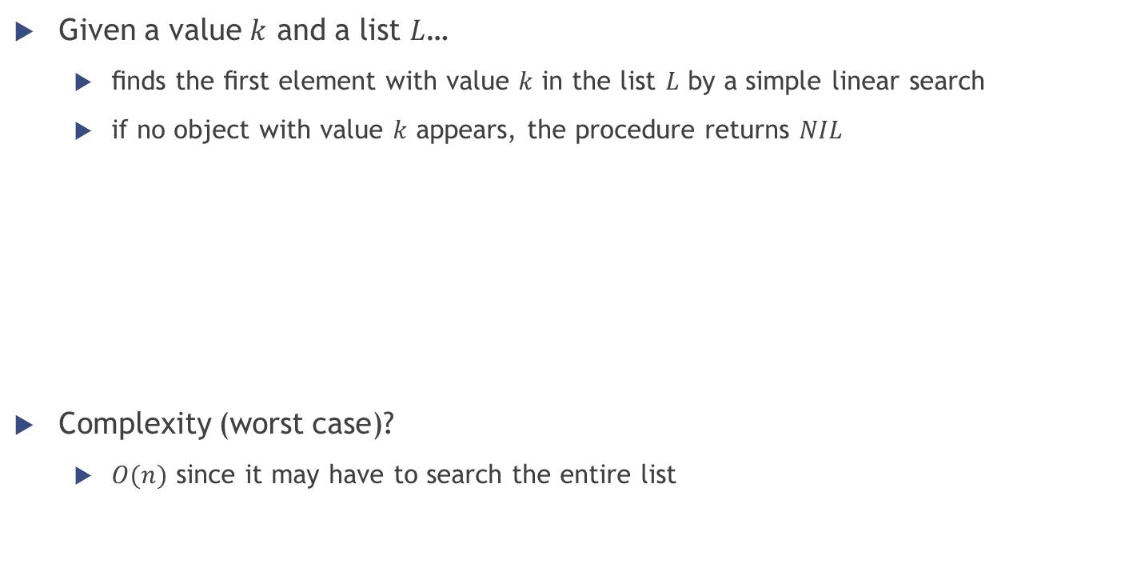
Linked list operations: SEARCH
Given a value $k$ and a list $L$…
ﬁnds the ﬁrst element with value $k$ in the list $L$ by a simple linear search
if no object with value $k$ appears, the procedure returns $NIL$
Complexity (worst case)?
$O(n)$ since it may have to search the entire list
LIST-SEARCH(L,k)
p = L.start
while p $≠$ NIL and p.data $≠$ k
p = p.next
return p

Slide 8
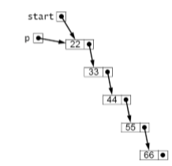
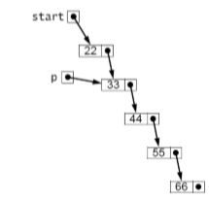
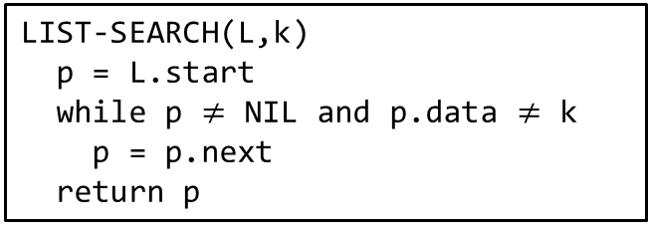

Linked list operations: SEARCH
LIST-SEARCH(L,k)
p = L.start
while p $≠$ NIL and p.data $≠$ k
p = p.next
return p
Example: looking for $k=44$
First iteration: $p$ is the start node (containing 22)
Second iteration: $p$ is the second node (containing 33)
Third (and last) iteration: $p$ is the third node (containing $k=$ 44)

Slide 9
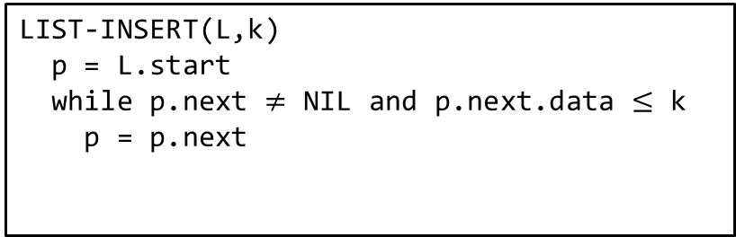

Linked list operations: INSERT
Given a value $k$ and a (sorted) list $L$…
ﬁnds the right position in the list for $k$ through a simple linear search
LIST-INSERT(L,k)
p = L.start
while p.next $≠$ NIL and p.next.data $≤$ k
p = p.next
looking for the position

Slide 10
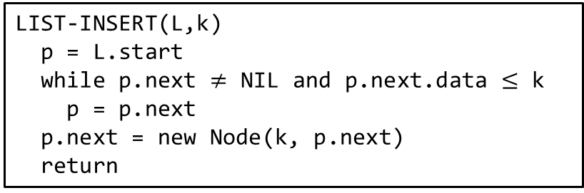

Linked list operations: INSERT
Given a value $k$ and a (sorted) list $L$…
ﬁnds the right position in the list for $k$ through a simple linear search
inserts a new element with value $k$ in such position
LIST-INSERT(L,k)
p = L.start
while p.next $≠$ NIL and p.next.data $≤$ k
p = p.next
p.next = new Node(k, p.next)
return
looking for the position
insertion of the new node

Slide 11
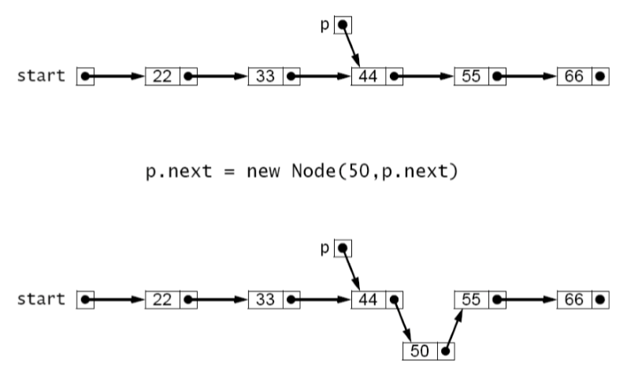
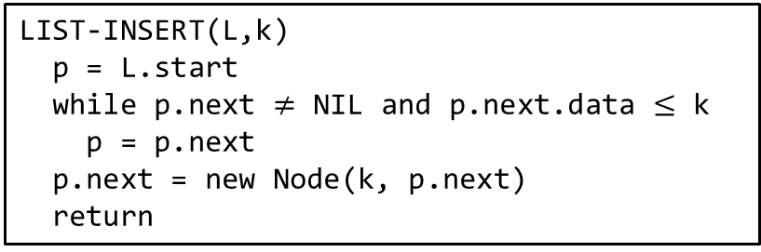
Linked list operations: INSERT
Example: inserting 50
LIST-INSERT(L,k)
p = L.start
while p.next $≠$ NIL and p.next.data $≤$ k
p = p.next
p.next = new Node(k, p.next)
return
looking for the position
insertion of the new node

Slide 12

Linked list operations: INSERT
What if we tried to insert 20 in the previous example?
LIST-INSERT(L,k)
p = L.start
while p.next $≠$ NIL and p.next.data $≤$ k
p = p.next
p.next = new Node(k, p.next)
return
looking for the position
insertion of the new node

Slide 13

Linked list operations: INSERT
What if we tried to insert 20 in the previous example?
Special case: insertion AT THE FRONT of the list
If the element to insert is smaller than the starting one
LIST-INSERT(L,k)
if L.start == NIL or L.start.data $>$ k
L.start = new Node(k, L.start)
return
p = L.start
while p.next $≠$ NIL and p.next.data $≤$ k
p = p.next
p.next = new Node(k, p.next)
return
insertion at the front
(if needed)
looking for the position
insertion of the new node

Slide 14
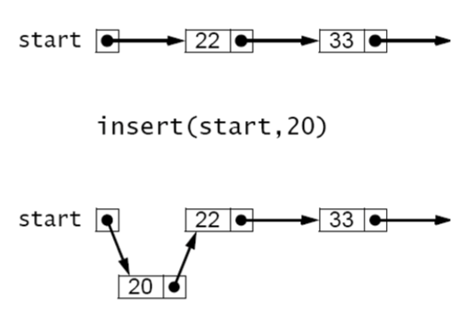

Linked list operations: INSERT
LIST-INSERT(L,k)
if L.start == NIL or L.start.data $>$ k
L.start = new Node(k, L.start)
return
x = L.start
while x.next $≠$ NIL and x.next.data $≤$ k
x = x.next
x.next = new Node(k, x.next)
return
insertion at the front
(if needed)
Example:
Inserting 20
looking for the position
insertion of the new node

Slide 15


Linked list operations: DELETE
Given a value $k$ and a (sorted) list $L$…
ﬁnds the first occurrence of the value $k$ in the list through a simple linear search
deletes such element (if it exists!)
LIST-DELETE(L,k)
p = L.start
while p.next $≠$ NIL and p.next.data $≤$ k
if p.next.data == k
p.next = p.next.next
return
p = p.next
return
looking for the position
deletion of the node

Slide 16
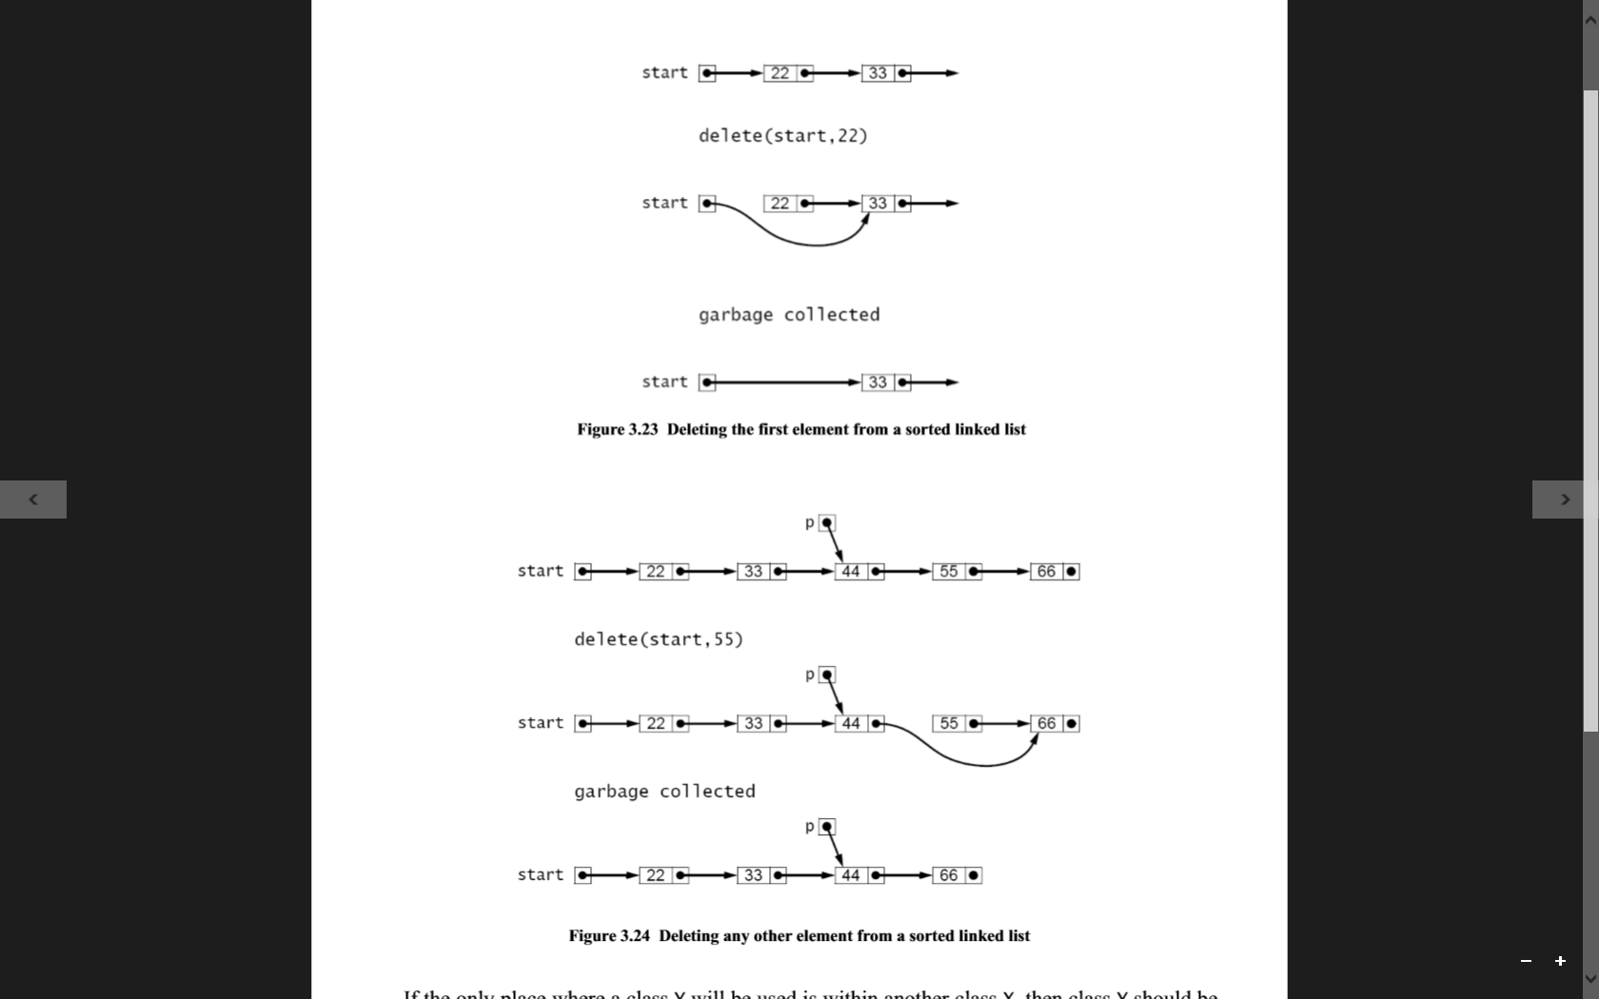

Linked list operations: DELETE
Example: deleting 55
LIST-DELETE(L,k)
p = L.start
while p.next $≠$ NIL and p.next.data $≤$ k
if p.next.data == k
p.next = p.next.next
return
p = p.next
return

Slide 17

Linked list operations: DELETE
And if we wanted to delete 22?
LIST-DELETE(L,k)
x = L.start
while x.next $≠$ NIL and x.next.data $≤$ k
if x.next.data == k
x.next = x.next.next
return
x = x.next
return
looking for the position
deletion of the node

Slide 18

Linked list operations: DELETE
And if we wanted to delete 22?
Special case: deleting the first element of the list
LIST-DELETE(L,k)
if L.start == NIL or L.start.data $>$ k
return
else if L.start.data == k
L.start = L.start.next
return
x = L.start
while x.next $≠$ NIL and x.next.data $≤$ k
if x.next.data == k
x.next = x.next.next
return
x = x.next
return
element not in the list
deleting the first element
looking for the position
deletion of the node

Slide 19

Linked list operations: DELETE
Example: deleting 22
LIST-DELETE(L,k)
if L.start == NIL or L.start.data $>$ k
return
else if L.start.data == k
L.start = L.start.next
return
x = L.start
while x.next $≠$ NIL and x.next.data $≤$ k
if x.next.data == k
x.next = x.next.next
return
x = x.next
return

Slide 20
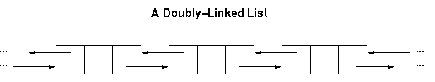
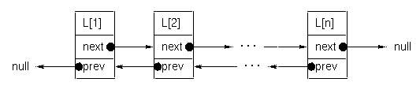
Doubly linked list
What if we want to move both forward and backward?
Add another reference to the node: the previous element in the list

Slide 21
Implementation exercises
public class Node<T> where T : IComparable {
T Value;
Node<T> Next;
}
public class SortedLinkedList<T> where T : IComparable {
Node<T> Start;
}
Write the code of all previous algorithms and to…
Insert a new value after/before a certain node in a doubly linked list
function insertAfter<T>(DLList<T> list, DLNode<T> node, T newValue)
function insertBefore<T>(DLList<T> list, DLNode<T> node, T newValue)
Insert a new value at the beginning and end of a doubly linked list
function insertBeginning<T>(DLList<T> list, T newValue)
function insertLast<T>(DLList<T> list, T newValue)
Delete a certain value in a doubly linked list
function remove<T>(DLList<T> list, T value)
public class DoublyLinkedNode<T> {
DoublyLinkedNode<T> Prev; // A reference to the previous node
DoublyLinkedNode<T> Next; // A reference to the next node
T Value;
}
public class DoublyLinkedList<T> {
DoublyLinkedNode<T> FirstNode; // points to first node of list
DoublyLinkedNode<T> LastNode; // points to last node of list
}

Slide 22

Stack

Slide 23

Stack – Definition
Collection implementing the LIFO protocol
LIFO = Last In First Out
Only accessible object: last one inserted
Operations allowed
Adding an element onto the top of the stack (PUSH)
Accessing the current element on the top of the stack (PEEK)
Removing the current element on the top of the stack (POP)
Notes:
The simplest application of a stack is to reverse a word. You push a given word to stack - letter by letter - and then pop letters from the stack.
Another application is an "undo" mechanism in text editors; this operation is accomplished by keeping all text changes in a stack.
Backtracking. This is a process when you need to access the most recent data element in a series of elements. Think of a labyrinth or maze - how do you find a way from an entrance to an exit? Once you reach a dead end, you must backtrack. But backtrack to where? to the previous choice point. Therefore, at each choice point you store on a stack all possible choices. Then backtracking simply means popping a next choice from the stack.
Language processing

Slide 24
Stack – Implementation
Built on top of other data structures
array, linked list, …
However, it implements always the same functionality
defined by the following interface
public interface StackInterface<T>
{
void push(T e);
T pop();
T peek();
boolean isEmpty();
}

Slide 25
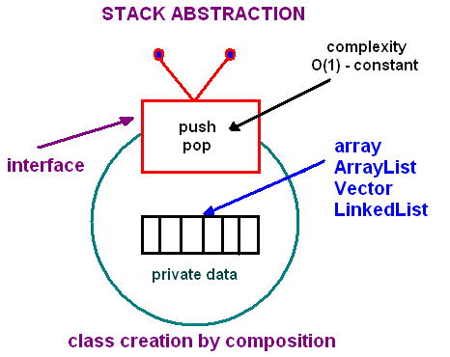
Stack – Implementation
Built on top of other data structures, but implementing always the same functionality

Slide 26
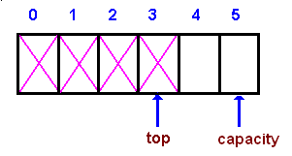
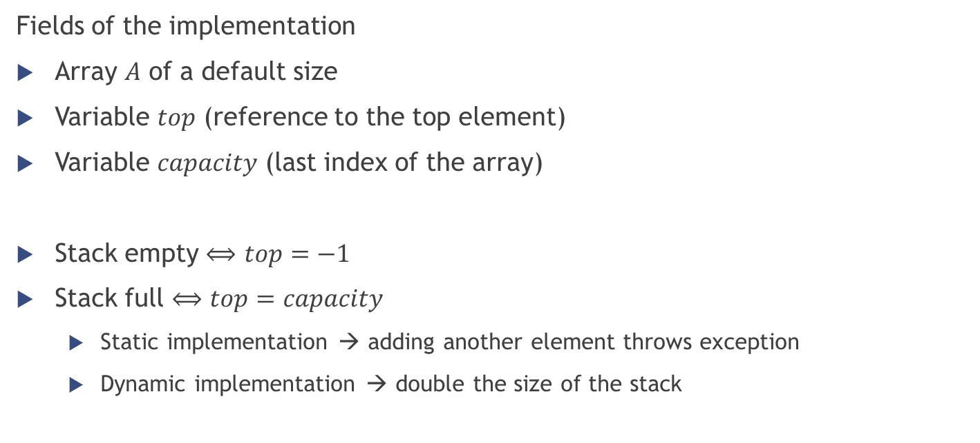
Stack – Indexed implementation
Fields of the implementation
Array $A$ of a default size
Variable $top$ (reference to the top element)
Variable $capacity$ (last index of the array)
Stack empty $⟺$ $top=−1$
Stack full $⟺$ $top=capacity$
Static implementation → adding another element throws exception
Dynamic implementation → double the size of the stack

Slide 27
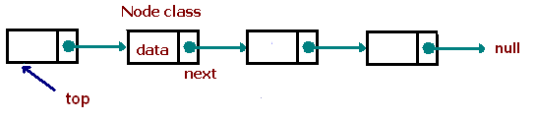
Stack – Linked implementation
Best (in efficiency) dynamic stack implementation
Be careful at the special case of empty stack
Top?
starting element of the list
Access (peek)?
Read the content of the top
Push?
Create a new node and add it at the beginning of the list
Pop?
Move the beginning of the list at the second element
Notes:
A nice example of the stack use would be the implementation of the “back” and “next” button in a browser.

Slide 28
Stack – Exercise
What is the content of the stack after executing all following operations?
Answer:
(note: the top of the stack is written at the left of the sequence)
Push(3)
Push(5)
Push(1)
Pop()
Pop()
Push(8)
Pop()
Pop()
Push(2)
Push(4)
Pop()
Push(7)
{ 7, 2 }

Slide 29
Queue

Slide 30
Queue – Definition
Collection implementing the FIFO protocol
FIFO = First In First Out
Only accessible object: first one inserted
In the stack it’s the opposite (last one inserted)
Operations allowed
Adding an element to the back of the queue (ENQUEUE)
Accessing the current element at the front of the queue (PEEK)
Removing the current element at the front of the queue (DEQUEUE)

Slide 31
Queue – Implementation
Built on top of other data structures
array, linked list, …
However, it implements always the same functionality
defined by the following interface
public interface QueueInterface‹T>
{
void enqueue(T e);
T peek();
T dequeue();
boolean isEmpty();
}

Slide 32
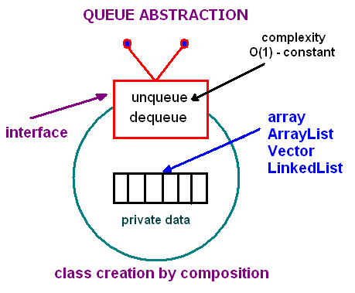
Queue – Implementation
Built on top of other data structures, but implementing always the same functionality

Slide 33
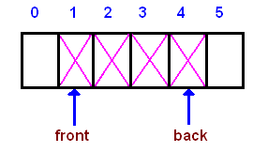
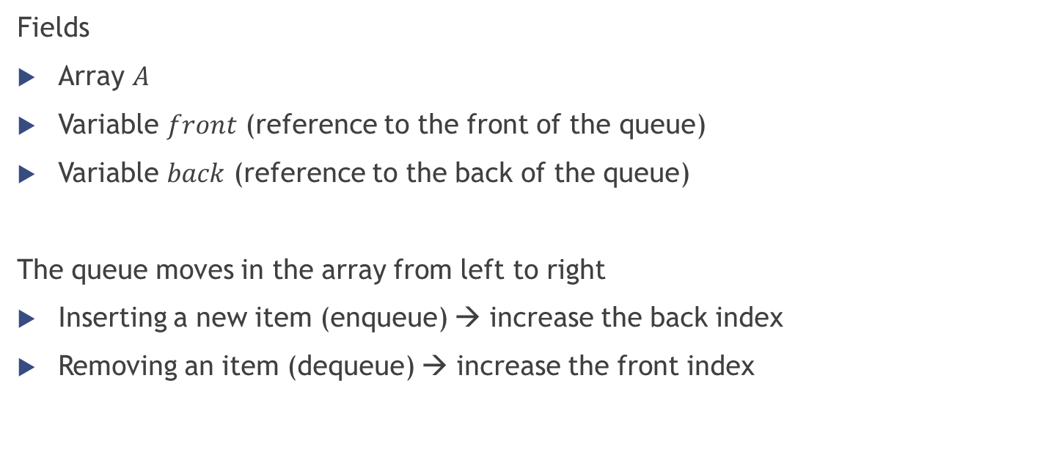
Queue – Indexed implementation
Fields
Array $A$
Variable $front$ (reference to the front of the queue)
Variable $back$ (reference to the back of the queue)
The queue moves in the array from left to right
Inserting a new item (enqueue) → increase the back index
Removing an item (dequeue) → increase the front index

Slide 34
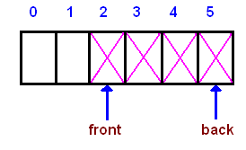
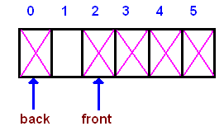
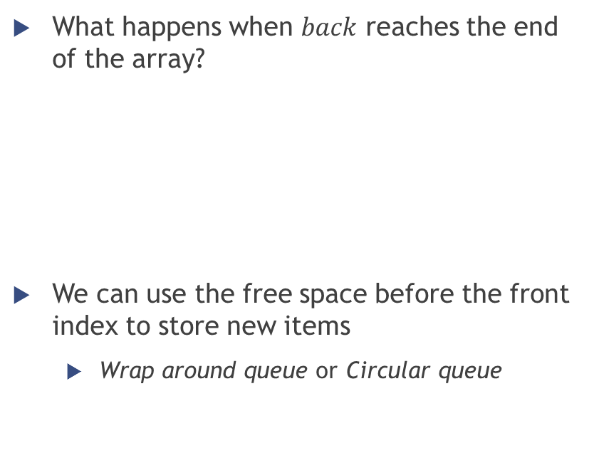
Queue – Indexed implementation
What happens when $back$ reaches the end of the array?
We can use the free space before the front index to store new items
Wrap around queue or Circular queue

Slide 35

Queue – Indexed implementation
And what happens when $back$reaches $front$?
The queue is completely full
Two choices to handle this situation (as with the stack)
Throw exception
Double the array size

Slide 36
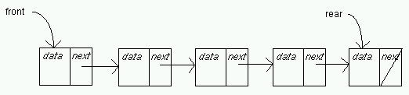
Queue – Linked implementation
Almost the same as the stack linked implementation
Here we maintain also a pointer to the last element
Front → starting element of the list
Rear → last element of the list
Enqueue
Create a new node and add it at the end of the list
Dequeue
Move the beginning of the list at the second element

Slide 37
Queue – Exercise
What is the content of the queue after executing all following operations?
Answer:
(note: the front of the queue is written at the left of the sequence)
Enqueue(3)
Enqueue(5)
Enqueue(1)
Dequeue()
Dequeue()
Enqueue(8)
Dequeue()
Enqueue(2)
Enqueue(4)
Dequeue()
Enqueue(7)
{ 2, 4, 7 }

Slide 38
Lists, stacks, queues in .NET
http://msdn.microsoft.com/en-US/library/ms379570(v=vs.80).aspx
http://msdn.microsoft.com/en-us/library/ms379571(v=vs.80).aspx
http://www.dotnetperls.com/list
http://www.dotnetperls.com/stack
http://www.dotnetperls.com/queue

Slide 39
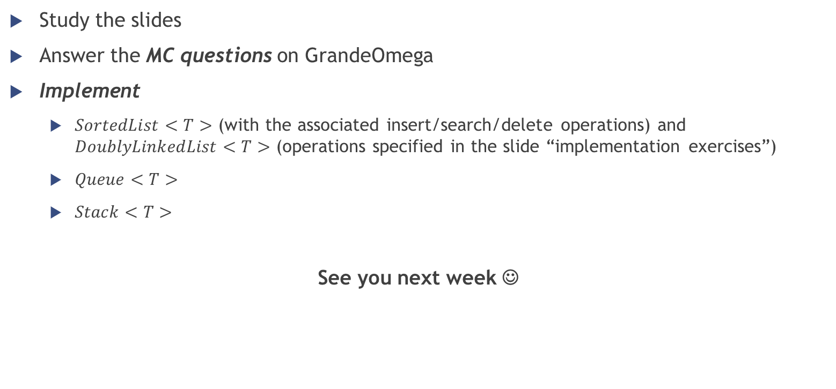
Homework
Study the slides
Answer the MC questions on GrandeOmega
Implement
$SortedList<T>$ (with the associated insert/search/delete operations) and $DoublyLinkedList<T>$ (operations specified in the slide “implementation exercises”)
$Queue<T>$
$Stack<T>$
See you next week ☺

